Slide 1
Tropical cyclones

Slide 2
What is a Cyclone?
A cyclone is simply an area of low pressure around which the winds flow counterclockwise in the Northern Hemisphere and clockwise in the Southern Hemisphere
Cyclones form and grow near the front
Cyclones (lows) are cloudy, wet, stormy

Slide 3
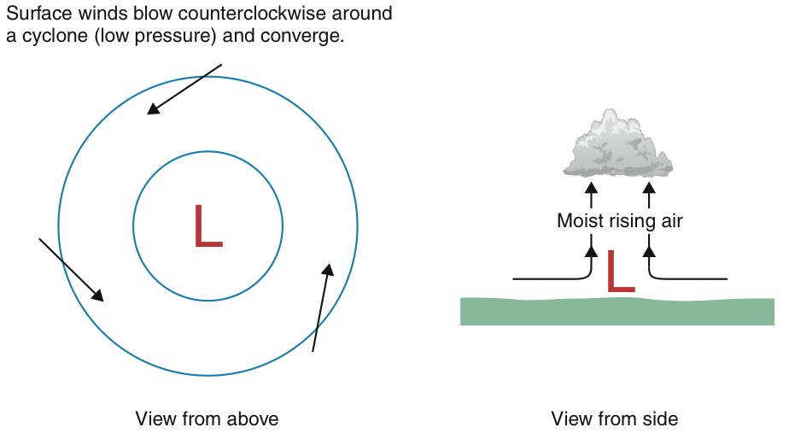
Cyclones have converging air at surface that rises!

Slide 4
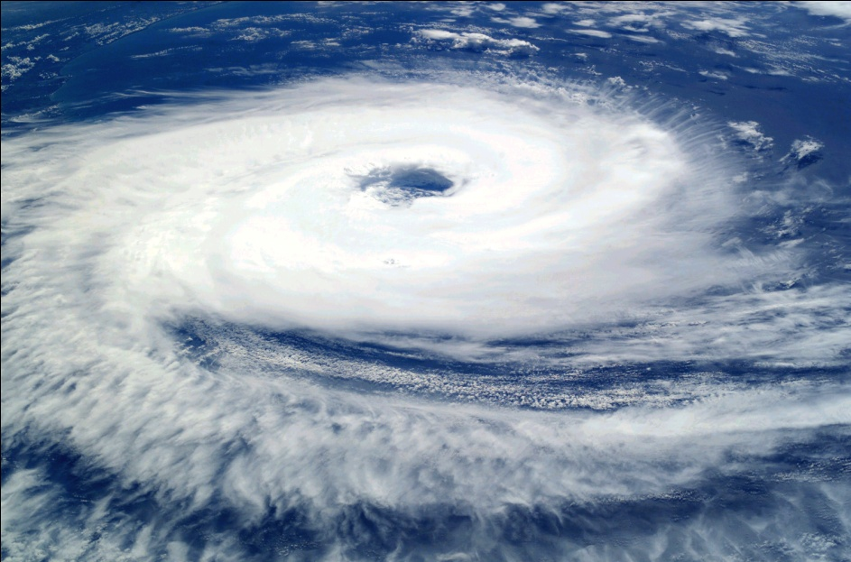
A cyclone is an area of closed, circular fluid motion rotating in the same direction as the Earth.
This is usually characterized by inward spiraling winds that rotate counterclockwise in the Northern Hemisphere and clockwise in the Southern Hemisphere of the Earth.
South Atlantic tropical cyclone
Cyclogenesis is the development or strengthening of cyclonic circulation in the atmosphere (a low pressure area)

Slide 5
Tropical cyclogenesis is the technical term describing the development and strengthening of a tropical cyclone in the atmosphere.
The mechanisms through which tropical cyclogenesis occurs are distinctly different from those through which mid-latitude cyclogenesis occurs.
Tropical cyclogenesis involves the development of a warm-core cyclone, due to significant convection in a favorable atmospheric environment.

Slide 6
Common Factors Favorable for Development
Warm Sea Surface Temperatures (SSTs)
Generally > 26.5°C
TCs are most common over waters > 28ºC
Low vertical wind shear near the center of the system
200 - 850 mb difference; usually < 20 m/s
TCs are most common in regions with shear < 10 m/s
Significant vorticity
Coriolis force; usually poleward of 5°
Most TCs occur in the 10º-20º latitudinal belts
Moist troposphere
Generally > 40-50% at mid-levels

Slide 7
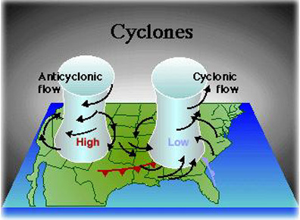
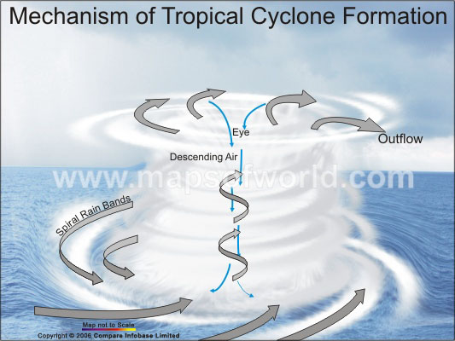
STAGE ONE
The start of a cyclone is when air heated by the sun rises which creates areas of very low air pressure. As the warm air rises it becomes loaded with moisture which condenses into huge thunder clouds.
STAGE TWO
Cool air rushes in to fill the void that is left, but because of the constant turning of the earth axis the air is bent inwards then spirals upwards with great force.

Slide 8
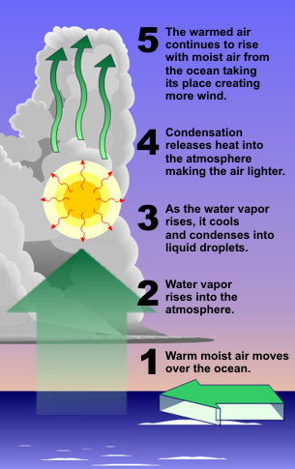
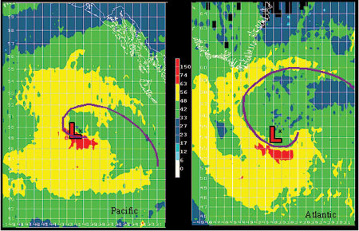
STAGE THREE
The swirling wind rotate faster and faster, forming a huge circle which can be up to 2,000 km across.
STAGE FOUR
At the centre of the storm is a calm, cloudless area called the eye where there no rain and the winds are fairly light.

Slide 9
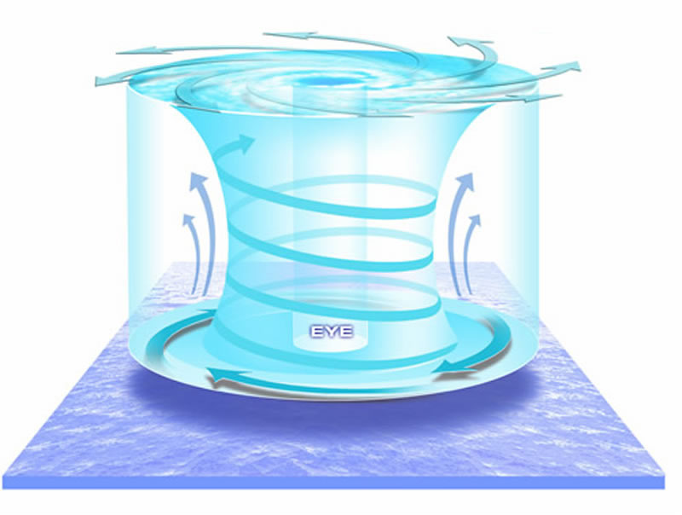
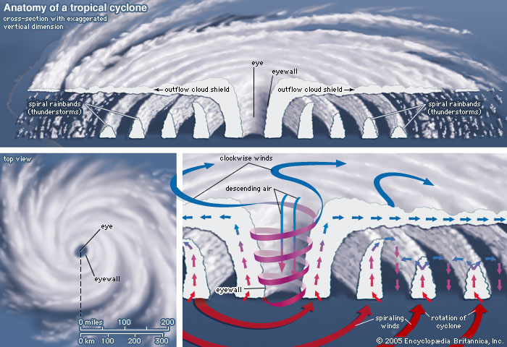
STAGE Five
As the cyclone build up it begins to move. It is sustained by a steady flow of moist air.
STAGE SIX
The strongest winds and heaviest rains around clouds which merge into a wall about 20-30 km from the storm’s centre.

Slide 10
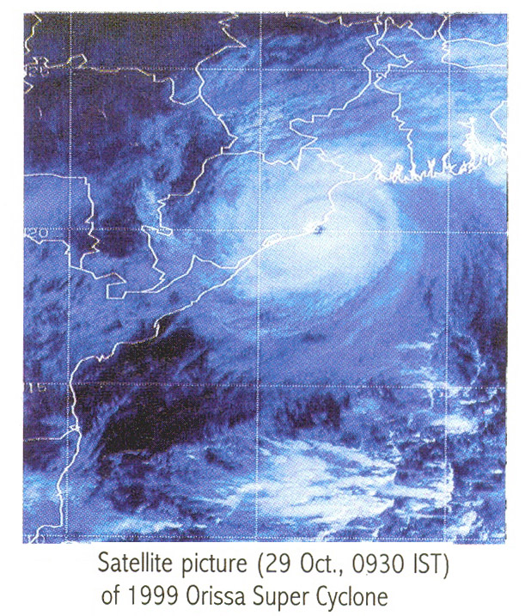
STAGE SEVEN
Winds around the eye can reach speeds of up to 200km/h and a fully developed cyclone pumps about 2 million tonnes of air per second. This results in more rain being released in a day falls in a year in a city like London.

Slide 11
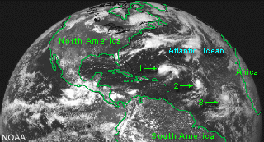
TROPICAL CYCLONES
BIRTH : Nearly all tropical storms/hurricanes start out as a tropical disturbance - an area of unsettled weather in the tropics.

Slide 12
Tropical Storm Cyclogenesis (Formation)
Hurricane season in the Atlantic Basin is defined between June 1 and November 30.
The peak in hurricane season is around September 10th, which corresponds to the time when ocean water in the tropics reaches its maximum temperature.

Slide 13
Tropical Cyclone Catagories
Tropical Cyclones are categorized by difference in their wind speed:
Tropical Depression = < 39 mph
Tropical Storm = 39 mph – 73 mph
Hurricane = > 74 mph
Major Hurricane = > 110 mph
Notes:
Tropical Depression Definition:
A Tropical Depression is a tropical cyclone with a closed wind circulation and maximum surface winds up to 34 KTs.
Tropical Depression Characteristics:
◉ Cloud systems produced by tropical depressions take on a variety of forms.
• The shape and appearance depends both on the type of lifting mechanism initiating their convection and the vertical wind shear of the storm’s environment.
• Satellite identification of cyclonic rotation can be difficult.
− Sometimes cyclonic cloud rotation can be identified through time-lapse loops or a pinwheel cloud pattern.

Slide 14
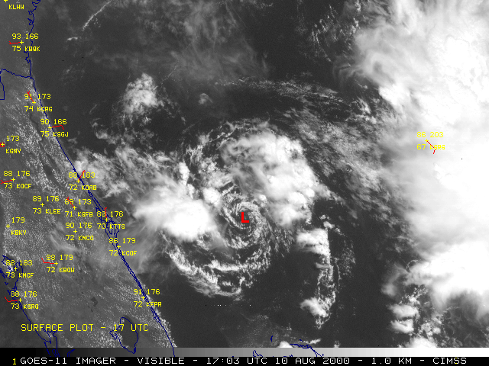
Tropical Cyclone Evolution
Tropical Depression = < 39 mph
Notes:
Tropical Depression Definition:
A Tropical Depression is a tropical cyclone with a closed wind circulation and maximum surface winds up to 34 KTs (39 mph).
Tropical Depression Characteristics:
Cloud systems produced by tropical depressions take on a variety of forms.
• The shape and appearance depends both on the type of lifting mechanism initiating their convection and the vertical wind shear of the storm’s environment.
• Satellite identification of cyclonic rotation can be difficult.
− Sometimes cyclonic cloud rotation can be identified through time-lapse loops or a pinwheel cloud pattern.

Slide 15
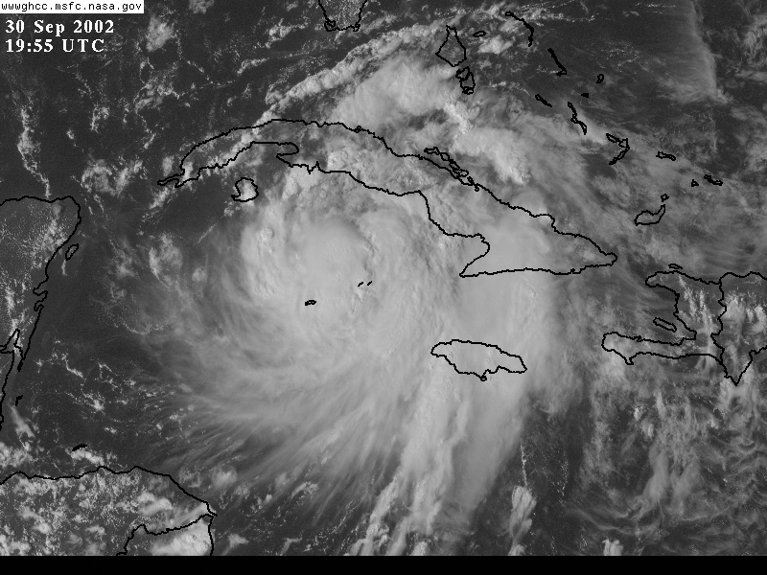
Tropical Cyclone Evolution
Tropical Storm = 39 mph - 74 mph
Notes:
Tropical Storm Definition:
A Tropical Storm is a tropical cyclone with maximum surface winds between 35 to 64 KTs.
Tropical Storm Characteristics:
◉  When a tropical depression matures into a tropical storm, its cloud rotation is usually more readily identifiable.
• This rotation can usually be identified through time-lapse imagery or a pinwheel cloud pattern.
◉ In this example of Tropical Storm Lili, the pinwheel pattern is easily identifiable.
• The low pressure center of the tropical storm is located near the center of the pinwheel.
As a tropical storm matures and strengthens, it modifies its immediate environment to the extent that storms in later stages of their development look much the same.

Slide 16
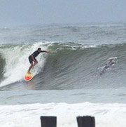
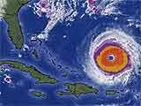
Tropical Cyclone Evolution
Hurricane = > 74 mph
Notes:
Hurricane Definition:
A Hurricane is a tropical cyclone with surface winds 65 KTs and greater.
Hurricane Characteristics:
◉  Common hurricanes features include:
• Eyes
• Eyewalls
• Central Dense Overcast (CDO)
• Spiral bands
◉ The more concentric and better defined these features appear, the stronger the hurricane.

Slide 17
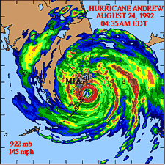
Tropical Cyclone Structure
Doppler radar showing hurricane main parts:
Eye
Eyewall
Rainbands.
Counter-clockwise rotation.
In very center of the storm, air sinks, forming an "eye" that is mostly cloud-free.

